Slide 1
Software Engineering
Topic 4
Design Engineering

Slide 2
Acknowledgement
These slides have been adapted from
Pressman, R.S. (2015). Software Engineering : A Practioner's Approach. 8th ed. McGraw-Hill Companies.Inc, Americas, New York. ISBN : 978 1 259 253157. Chapter 12, 13, 14, 15, 16, 17, and 18

Slide 3
Learning Objectives
LO2 : Explain the software engineering practices and business environment

Slide 4
Contents
Software Architecture
Architectural Design
Component Level Design
Interface Design
Design Evaluation Cycle
Design Patterns
Architectural Patterns
WebApps Design
MobileApps Design

Slide 5
SOFTWARE ARCHITECTURE

Slide 6
Software Architecture
The architecture is not the operational software. Rather, it is a representation that enables a software engineer to:
(1) analyze the effectiveness of the design in meeting its stated requirements,
(2) consider architectural alternatives at a stage when making design changes is still relatively easy, and
(3) reduce the risks associated with the construction of the software.

Slide 7
Software Architecture
Architectural Styles
Each style describes a system category that encompasses: (1) a set of components (e.g., a database, computational modules) that perform a function required by a system, (2) a set of connectors that enable “communication, coordination and cooperation” among components, (3) constraints that define how components can be integrated to form the system, and (4) semantic models that enable a designer to understand the overall properties of a system by analyzing the known properties of its constituent parts.
Data-centered architectures
Data flow architectures
Call and return architectures
Object-oriented architectures
Layered architectures

Slide 8
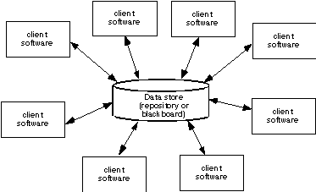
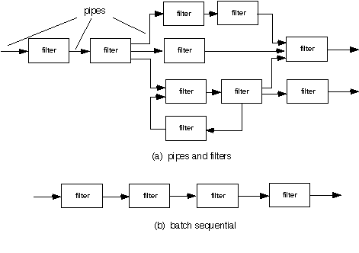
Software Architecture
Data Centered Architecture
Data Flow
Architecture

Slide 9
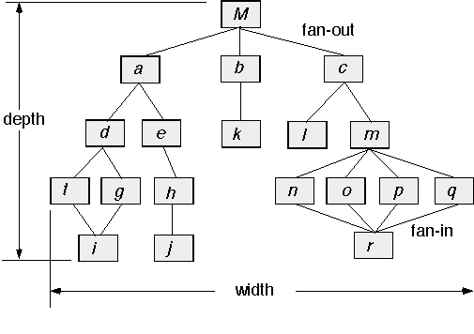
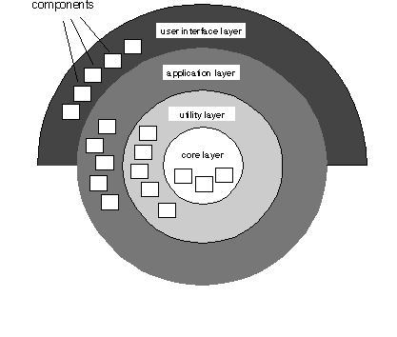
Software Architecture
Call and Return Architecture
Layered
Architecture

Slide 10
ARCHITECTURAL DESIGN

Slide 11
Architectural Design
The software must be placed into context
  the design should define the external entities (other systems, devices, people) that the software interacts with and the nature of the interaction
A set of architectural archetypes should be identified
  An archetype is an abstraction (similar to a class) that represents one element of system behavior
The designer specifies the structure of the system by defining and refining software components that implement each archetype

Slide 12
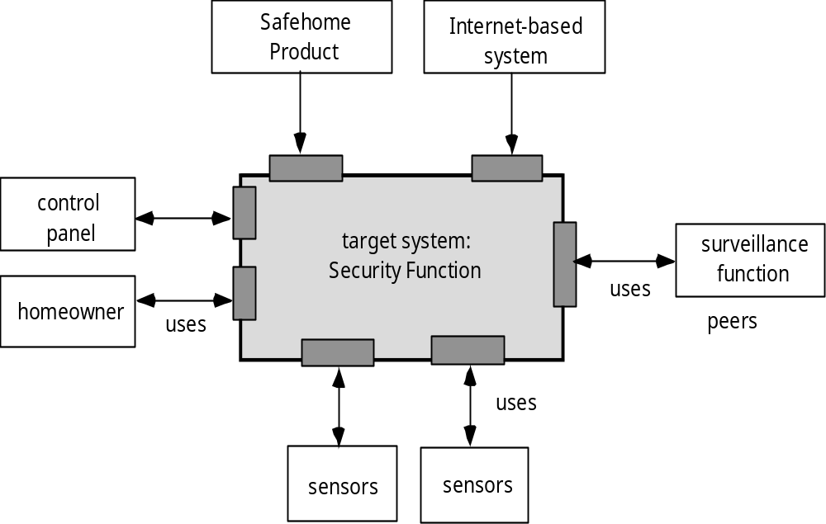
Architectural Design
Architectural Context

Slide 13
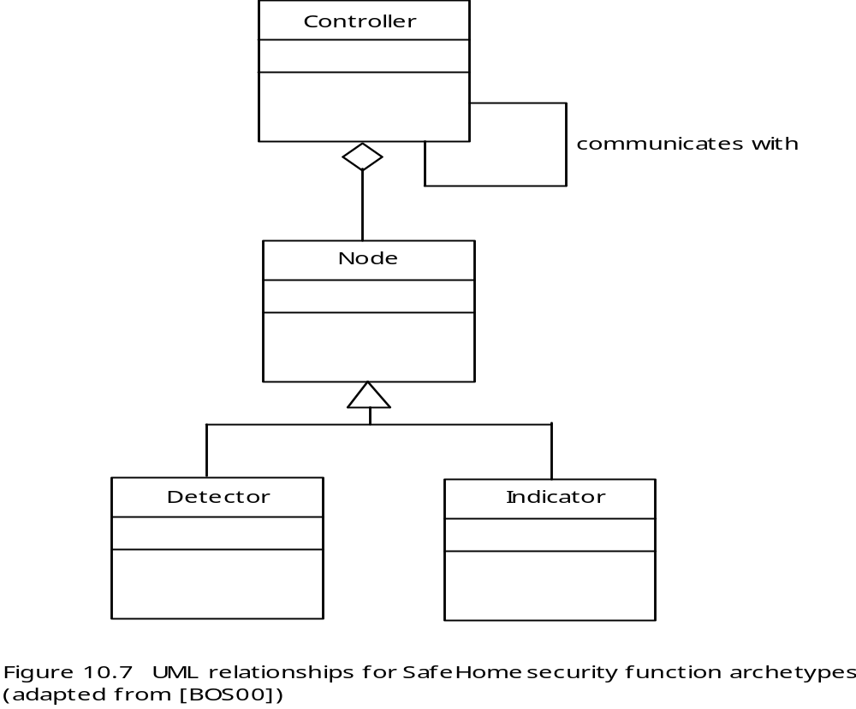
Architectural Design
Archetypes

Slide 14
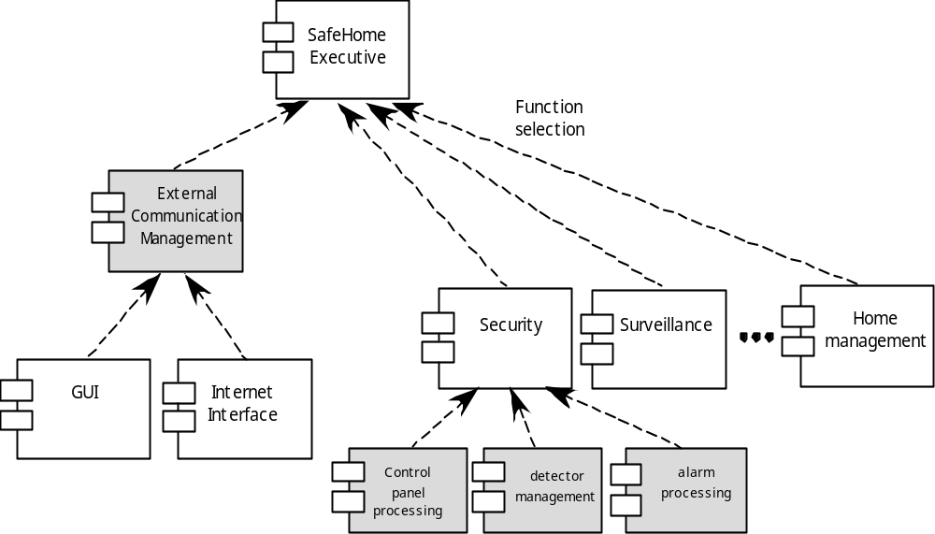
Architectural Design
Component Structure

Slide 15
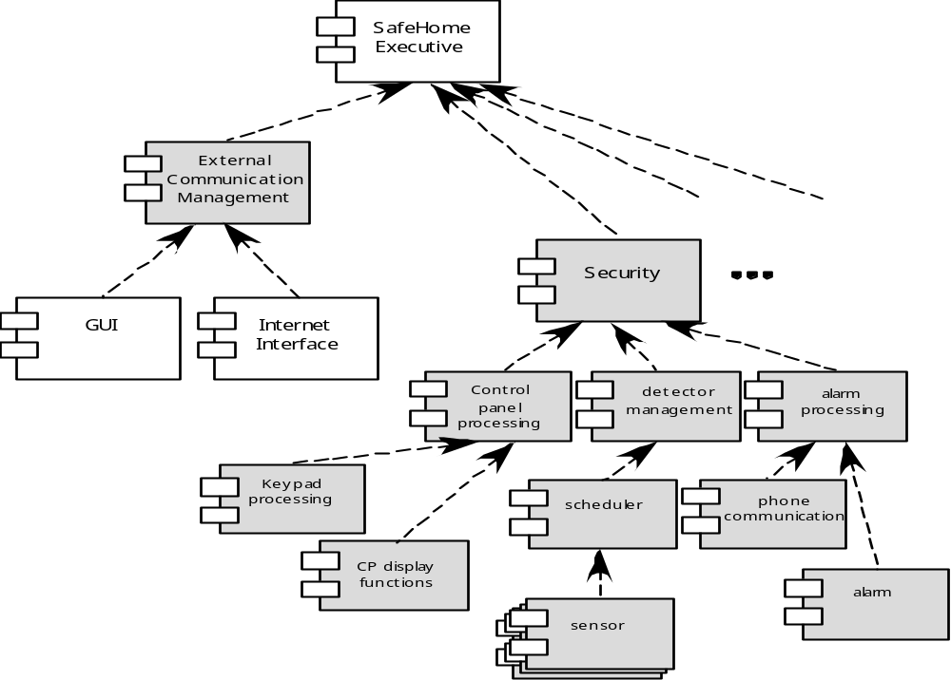
Architectural Design
Refined Component Structure

Slide 16
COMPONEN LEVEL DESIGN

Slide 17
Component Level Design
OMG Unified Modeling Language Specification [OMG01] defines a component as
  “… a modular, deployable, and replaceable part of a system that encapsulates implementation and exposes a set of interfaces.”
OO view: a component contains a set of collaborating classes
Conventional view: a component contains processing logic, the internal data structures that are required to implement the processing logic, and an interface that enables the component to be invoked and data to be passed to it.

Slide 18
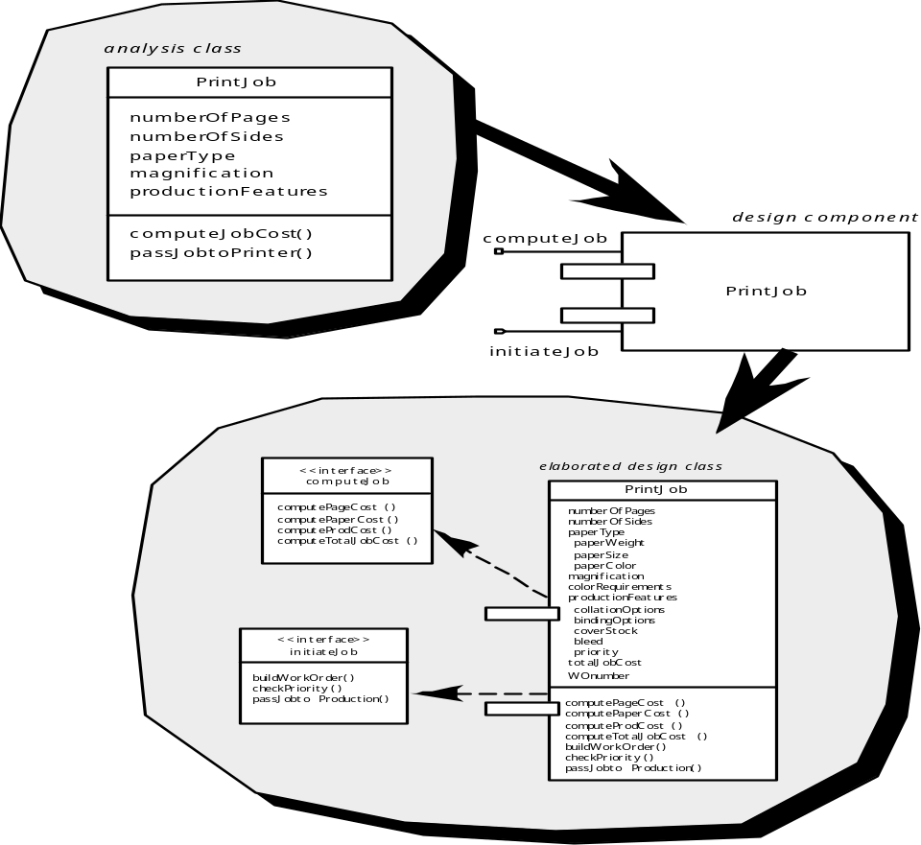
Component Level Design
OO Component

Slide 19
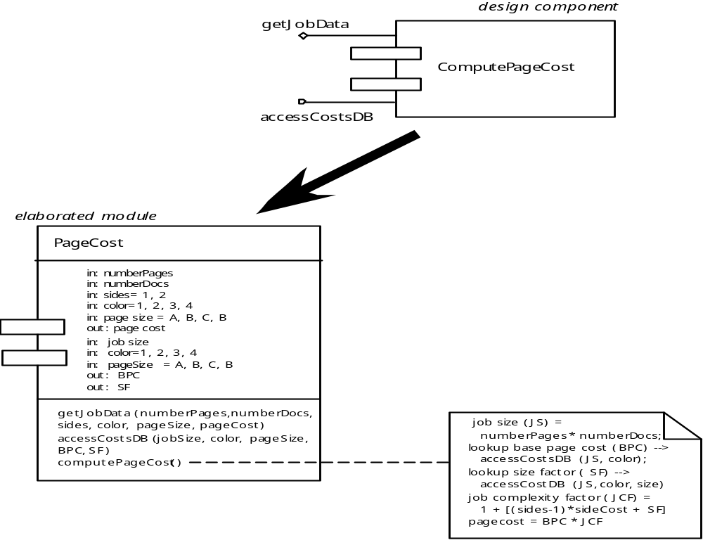
Component Level Design
Conventional Component

Slide 20
Component Level Design
Cohesion
Conventional view:
  the “single-mindedness” of a module
OO view:
  cohesion implies that a component or class encapsulates only attributes and operations that are closely related to one another and to the class or component itself
Levels of cohesion
  Functional
  Layer
  Communicational
  Sequential
  Procedural
  Temporal
  utility

Slide 21
Component Level Design
Coupling
Conventional view:
  The degree to which a component is connected to other components and to the external world
OO view:
  a qualitative measure of the degree to which classes are connected to one another
Level of coupling
  Content
  Common
  Control
  Stamp
  Data
  Routine call
  Type use
  Inclusion or import
  External

Slide 22
Component Level Design
Component Design for WebApps
WebApp component is
  (1) a well-defined cohesive function that manipulates content or provides computational or data processing for an end-user, or
  (2) a cohesive package of content and functionality that provides end-user with some required capability.
Therefore, component-level design for WebApps often incorporates elements of content design and functional design.

Slide 23
Component Level Design
Component-Based Development
When faced with the possibility of reuse, the software team asks:
  Are commercial off-the-shelf (COTS) components available to implement the requirement?
  Are internally-developed reusable components available to implement the requirement?
  Are the interfaces for available components compatible within the architecture of the system to be built?
At the same time, they are faced with the following impediments to reuse ...

Slide 24
Component Level Design
User Interface Design Models
User model — a profile of all end users of the system
Design model — a design realization of the user model
Mental model (system perception) — the user’s mental image of what the interface is
Implementation model — the interface “look and feel” coupled with supporting information that describe interface syntax and semantics

Slide 25
INTERFACE DESIGN

Slide 26

Interface Design
User Interface Design Process

Slide 27
Interface Design
Interface Analysis
Interface analysis means understanding
  (1) the people (end-users) who will interact with the system through the interface;
  (2) the tasks that end-users must perform to do their work,
  (3) the content that is presented as part of the interface
  (4) the environment in which these tasks will be conducted.

Slide 28
Interface Design
Task Analysis and Modeling
Answers the following questions …
  What work will the user perform in specific circumstances?
  What tasks and subtasks will be performed as the user does the work?
  What specific problem domain objects will the user manipulate as work is performed?
  What is the sequence of work tasks—the workflow?
  What is the hierarchy of tasks?
Use-cases define basic interaction
Task elaboration refines interactive tasks
Object elaboration identifies interface objects (classes)
Workflow analysis defines how a work process is completed when several people (and roles) are involved

Slide 29
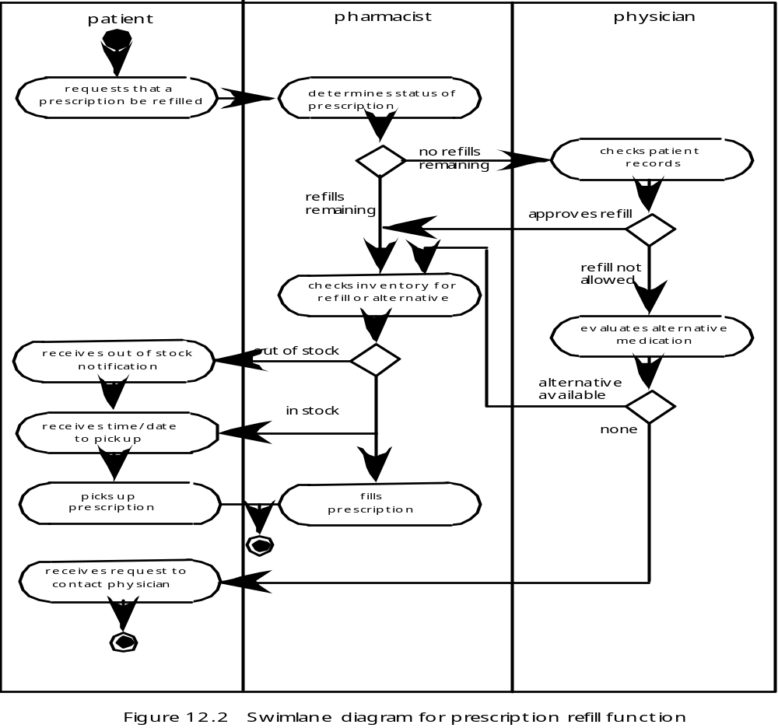
Interface Design
Swimlane Diagram

Slide 30
Interface Design
Interface Design Steps
Using information developed during interface analysis, define interface objects and actions (operations).
Define events (user actions) that will cause the state of the user interface to change. Model this behavior.
Depict each interface state as it will actually look to the end-user.
Indicate how the user interprets the state of the system from information provided through the interface.

Slide 31
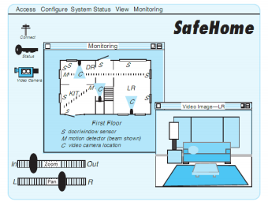
Interface Design
Preliminary screen layout

Slide 32
WEB AND MOBILE INTERFACE DESIGN

Slide 33
WebApp and Mobile
Interface Design
Interface Design Principles - I
Anticipation—A WebApp should be designed so that it anticipates the use’s next move.
Communication—The interface should communicate the status of any activity initiated by the user
Consistency—The use of navigation controls, menus, icons, and aesthetics (e.g., color, shape, layout)
Controlled autonomy—The interface should facilitate user movement throughout the WebApp, but it should do so in a manner that enforces navigation conventions that have been established for the application.
Efficiency—The design of the WebApp and its interface should optimize the user’s work efficiency, not the efficiency of the Web engineer who designs and builds it or the client-server environment that executes it.

Slide 34
WebApp and Mobile
Interface Design
Interface Design Principles - II
Focus—The WebApp interface (and the content it presents) should stay focused on the user task(s) at hand.
Fitt’s Law—“The time to acquire a target is a function of the distance to and size of the target.”
Human interface objects—A vast library of reusable human interface objects has been developed for WebApps.
Latency reduction—The WebApp should use multi-tasking in a way that lets the user proceed with work as if the operation has been completed.
Learnability— A WebApp interface should be designed to minimize learning time, and once learned, to minimize relearning required when the WebApp is revisited.

Slide 35
WebApp and Mobile
Interface Design
Interface Design Principles-III
Maintain work product integrity—A work product (e.g., a form completed by the user, a user specified list) must be automatically saved so that it will not be lost if an error occurs.
Readability—All information presented through the interface should be readable by young and old.
Track state—When appropriate, the state of the user interaction should be tracked and stored so that a user can logoff and return later to pick up where she left off.
Visible navigation—A well-designed WebApp interface provides “the illusion that users are in the same place, with the work brought to them.”

Slide 36
WebApp and Mobile
Interface Design
Interface Design Workflow-I
Review information contained in the analysis model and refine as required.
Develop a rough sketch of the WebApp interface layout.
Map user objectives into specific interface actions.
Define a set of user tasks that are associated with each action.
Storyboard screen images for each interface action.
Refine interface layout and storyboards using input from aesthetic design.

Slide 37
WebApp and Mobile Interface Design
Interface Design Workflow-II
Identify user interface objects that are required to implement the interface.
Develop a procedural representation of the user’s interaction with the interface.
Develop a behavioral representation of the interface.
Describe the interface layout for each state.
Refine and review the interface design model.

Slide 38
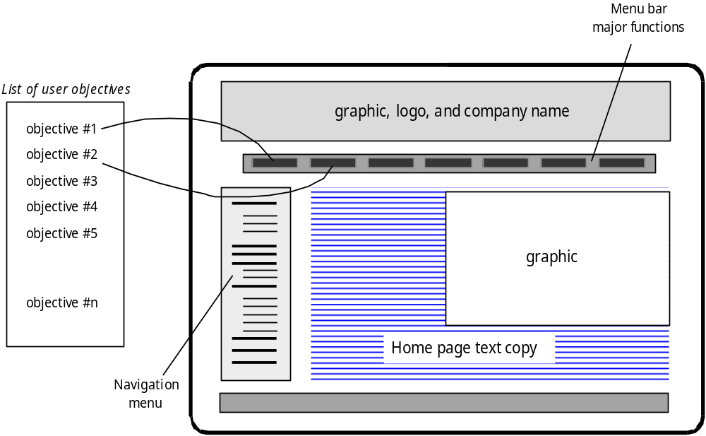
WebApp and Mobile Interface Design
The interface design evaluation cycle

Slide 39
DESIGN PATTERNS

Slide 40
Effective Patterns
Design Patterns
Coplien [Cop05] characterizes an effective design pattern in the following way:
  It solves a problem: Patterns capture solutions, not just abstract principles or strategies.
  It is a proven concept: Patterns capture solutions with a track record, not theories or speculation.
  The solution isn't obvious: Many problem-solving techniques (such as software design paradigms or methods) try to derive solutions from first principles. The best patterns generate a solution to a problem indirectly--a necessary approach for the most difficult problems of design.
  It describes a relationship: Patterns don't just describe modules, but describe deeper system structures and mechanisms.
  The pattern has a significant human component (minimize human intervention). All software serves human comfort or quality of life; the best patterns explicitly appeal to aesthetics and utility.

Slide 41
Generative Patterns
Design Patterns
Generative patterns describe an important and repeatable aspect of a system and then provide us with a way to build that aspect within a system of forces that are unique to a given context.
A collection of generative design patterns could be used to “generate” an application or computer-based system whose architecture enables it to adapt to change.

Slide 42
Describing a Pattern
Design Patterns
Pattern name—describes the essence of the pattern in a short but expressive name
Problem—describes the problem that the pattern addresses
Motivation—provides an example of the problem
Context—describes the environment in which the problem resides including application domain
Forces—lists the system of forces that affect the manner in which the problem must be solved; includes a discussion of limitation and constraints that must be considered
Solution—provides a detailed description of the solution proposed for the problem
Intent—describes the pattern and what it does
Collaborations—describes how other patterns contribute to the solution
Consequences—describes the potential trade-offs that must be considered when the pattern is implemented and the consequences of using the pattern
Implementation—identifies special issues that should be considered when implementing the pattern
Known uses—provides examples of actual uses of the design pattern in real applications
Related patterns—cross-references related design patterns

Slide 43
Pattern-Based Design
Design Patterns
A software designer begins with a requirements model (either explicit or implied) that presents an abstract representation of the system.
The requirements model describes the problem set, establishes the context, and identifies the system of forces that hold sway.
Then …

Slide 44
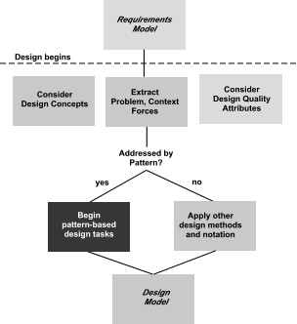
Pattern-based design in context
Design Patterns

Slide 45
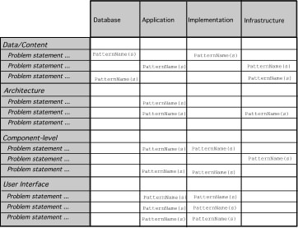
Pattern Organizing Table
Design Patterns

Slide 46
Architectural Patterns
Example: every house (and every architectural style for houses) employs a Kitchen pattern.
The Kitchen pattern and patterns it collaborates with address problems associated with the storage and preparation of food, the tools required to accomplish these tasks, and rules for placement of these tools relative to workflow in the room.
In addition, the pattern might address problems associated with counter tops, lighting, wall switches, a central island, flooring, and so on.
Obviously, there is more than a single design for a kitchen, often dictated by the context and system of forces. But every design can be conceived within the context of the ‘solution’ suggested by the Kitchen pattern.

Slide 47
Design & WebApp Quality
WebApps Design
Security
  Rebuff external attacks
  Exclude unauthorized access
  Ensure the privacy of users/customers
Availability
  the measure of the percentage of time that a WebApp is available for use
Scalability
  Can the WebApp and the systems with which it is interfaced handle significant variation in user or transaction volume
Time to Market

Slide 48
WEBAPPS DESIGN

Slide 49
Quality Dimensions for End-Users
WebApps Design
Time
  How much has a Web site changed since the last upgrade?
  How do you highlight the parts that have changed?
Structural
  How well do all of the parts of the Web site hold together.
  Are all links inside and outside the Web site working?
  Do all of the images work?
  Are there parts of the Web site that are not connected?
Content
  Does the content of critical pages match what is supposed to be there?
  Do key phrases exist continually in highly-changeable pages?
  Do critical pages maintain quality content from version to version?
  What about dynamically generated HTML pages?

Slide 50
Quality Dimensions for End-Users
WebApps Design
Accuracy and Consistency
  Are today's copies of the pages downloaded the same as yesterday's? Close enough?
  Is the data presented accurate enough? How do you know?
Response Time and Latency
  Does the Web site server respond to a browser request within certain parameters?
  In an E-commerce context, how is the end to end response time after a SUBMIT?
  Are there parts of a site that are so slow the user declines to continue working on it?
Performance
  Is the Browser-Web-Web site-Web-Browser connection quick enough?
  How does the performance vary by time of day, by load and usage?
  Is performance adequate for E-commerce applications?

Slide 51
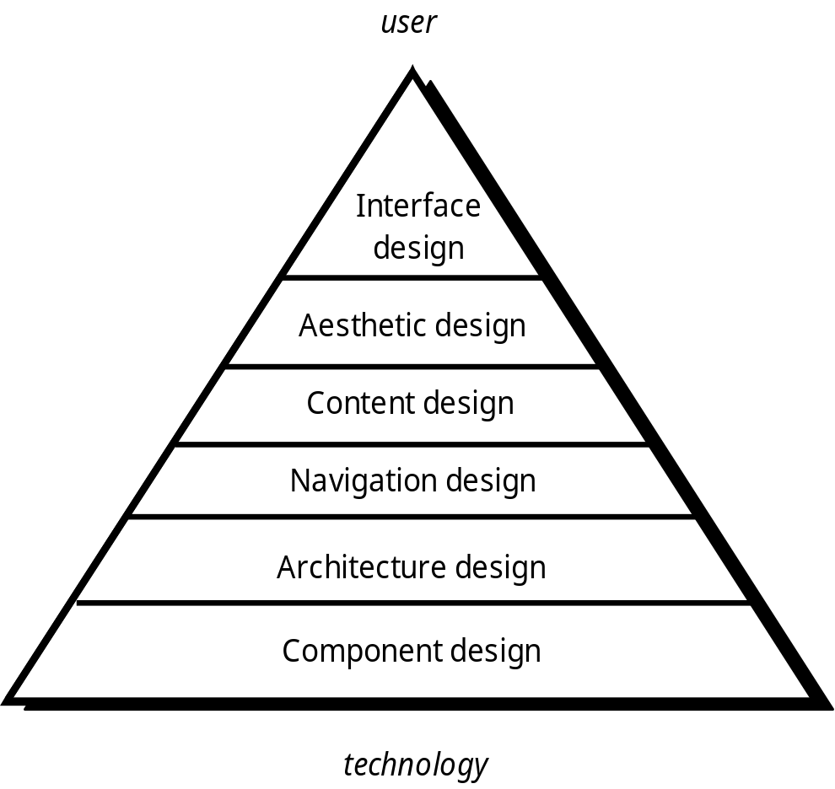
Design Pyramid for WebApps
WebApps Design

Slide 52
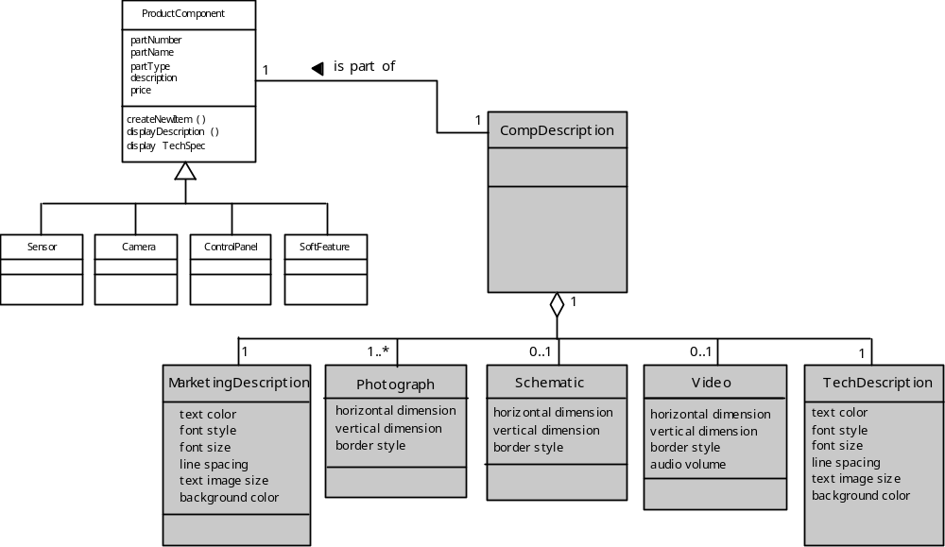
Design representation of content objects
WebApps Design

Slide 53
MOBILE APPS DESIGN

Slide 54
MobileApp Design
Development Considerations
  Like all computing devices, mobile platforms are differentiated by the software they deliver – a combination of operating system (e.g., Android or iOS) and a small subset of the hundreds of thousands of MobileApps that provide a very wide range of functionality.
  New tools allow individuals with little formal training to create and sell apps alongside other apps developed by large teams of software developers.

Slide 55
MobileApp Design
Technical Considerations
  Multiple hardware and software platforms
  Many development frameworks and programming languages
  Many app store with different rules and tools
  Very short development cycles
  UI limitations and complexities of interaction with sensors and cameras
  Effective use of context
  Power management
  Security and privacy models and policies
  Computational and storage limitations
  Application that depend on external services
  Testing complexity

Slide 56
MobileApp Design
Best Practices
  Identify your audience
  Design for context of use
  There is a fine line between simlicity and laziness
  Use the platform as an advantage
  Make scrollbars and selection highlighting more salient
  Increase discoverability of advanced functionality
  Use clear and consistent labels
  Clever icons should never be developed at the expense of user under standing
  Support user expectations for personalization
  Long scrolling forms trump multiple screens on mobile device

Slide 57
References
Pressman, R.S. (2015). Software Engineering : A Practioner's Approach. 8th ed. McGraw-Hill Companies.Inc, Americas, New York. ISBN : 978 1 259 253157.
﻿Guide to the Software Engineering Body of Knowledge, SWEBOK, https://www.computer.org/education/bodies-of-knowledge/software-engineering
UML Specification, https://www.omg.org/spec/UML/About-UML/
Introduction to Software Architecture, http://www.youtube.com/watch?v=x30DcBfCJRI
Component-based game engine, http://www.youtube.com/watch?v=_K4Mc3t9Rtc
software design pattern, http://www.youtube.com/watch?v=ehGl_V61WJw

Slide 58
Q & A

